Slide 1
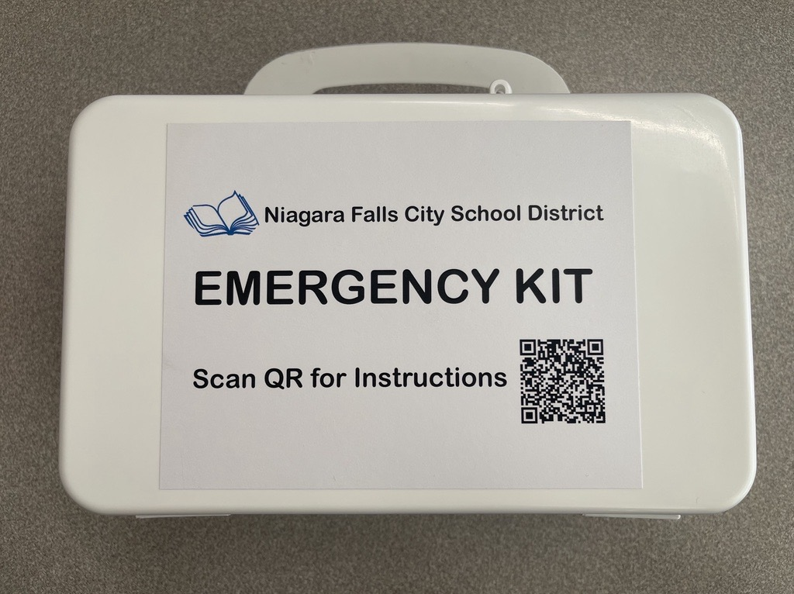
Niagara Falls City School District Emergency Kit Instructional Video
For any additional questions, please contact the Nurse Practitioner’s Office
716-286-0788

Slide 2
Survival Rescue Blanket

Slide 3
Glucose Gel

Slide 4
Emergency Drinking Water

Slide 5
Please watch the following video on how to properly put on and remove gloves:
https://youtu.be/PWrhmp3YAc0?si=koUNrFNk8OdPL7wo

Slide 6
Emergency First Aid Supplies

Slide 7
Emergency Trauma Dressing

Slide 8
Please watch the following video on how to properly use the emergency trauma dressing:
https://www.youtube.com/watch?v=KyJ5IEOffVQ

